Slide 1







DDR & jQuery
More than just hover & dropdown
Lee Wise / Front End Developer
@theleewise

Slide 2
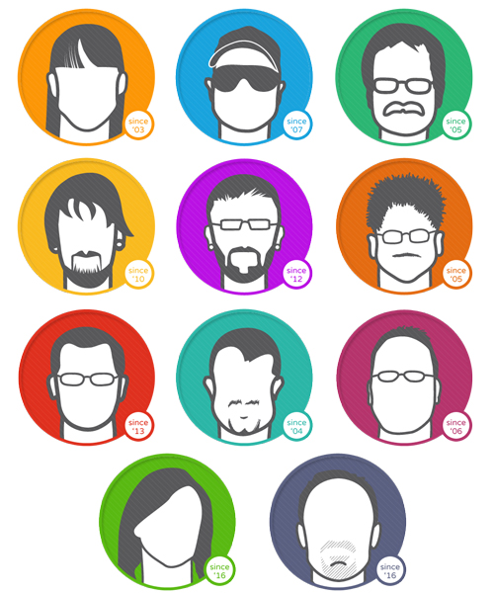
10 Pound Gorilla Team
Everything DNN
Skins
Modules
Development
Consulting
Everything Else
Internet Marketing
Web Development
Graphic Design
SEO
Social Media Marketing
Adwords
Online Marketing
Email Marketing

Slide 3
What’s so great about DDR?
  Simple upgrade for standard SolPartMenu and DNNMenu.
  Helps with SEO
  Works on mobile and accessible browsers.
  Allows server-side alteration or replacement of the menu structure.
  Can display a subset of pages, e.g. top-level only, children of current page, etc
  Can be used as either a module or a skin object.
  Can be templated to produce any HTML you want.
  Automatically detects and uses Apollo, Ealo and Adequation page localization

Slide 4
Why are templates so great?
Create it exactly how you need
It can always be unique & different
Use many jQuery plug-ins
(Even if they weren’t originally for DNN and DDR Menu)

Slide 5
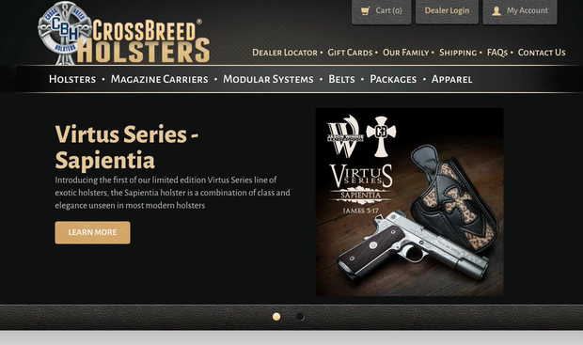

Slide 6
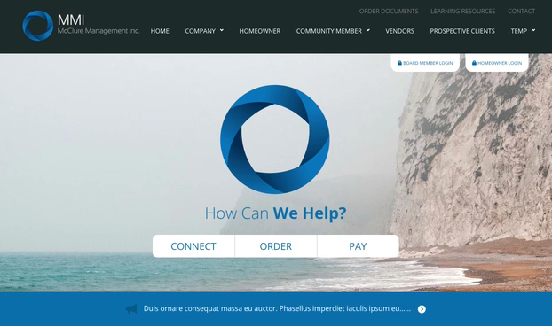

Slide 7
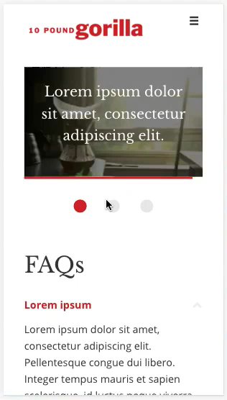

Slide 8
DDR Templates
How-To

Slide 9

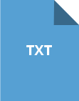
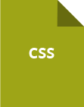

What’s Needed
Manifest (XML)
Template (TXT, XSLT, or Razor)
Styles (CSS)
Scripts (JS)

Slide 10
Where is all this?
Container (action menus only)
Skin
Portal Root
DesktopModules/DDRMenu
Application Root

Slide 11
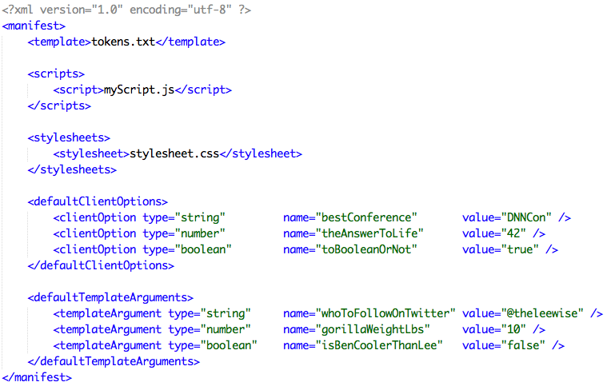
Manifest (XML)

Slide 12


Scripts & Styles
This defines the paths of JavaScript’s file to import.
This defines the paths of CSS files to import.

Slide 13
Scripts & Styles (Cont)
[MANIFEST]/filename: In the folder containing the menu manifest
(e.g. ~/Portals/0/skins/MySkin/MyTemplate/filename)
[SKIN]/filename: In the current skin folder
(e.g. ~/Portals/0/skins/MySkin/filename)
[DDRMENU]/filename: In the DDRMenu folder
(i.e. ~/DesktopModules/DDRMenu/filename)
[PORTAL]/filename: In the portal root
(e.g. ~/Portals/0/filename)
[DNN]/filename: In the DNN application root
(i.e. ~/filename)
~/filename: In the DNN application root.

Slide 14
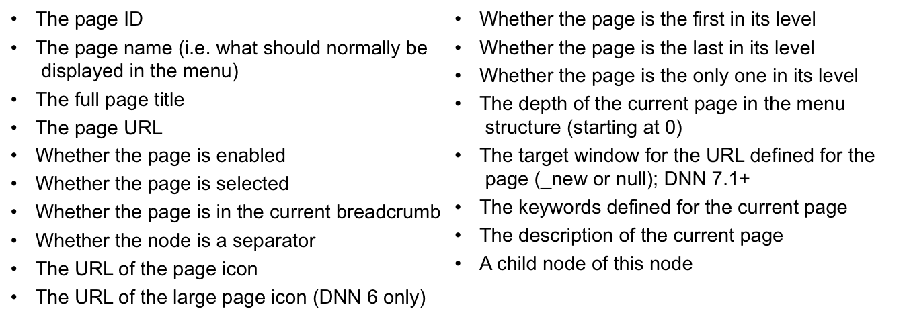
Available Attributes
<li class=“@first @last @enabled” id=“nav-page-@id”>
*Simplified Example, Non-working code.

Slide 15
Additional Attributes for Razor
The parent node of this node
The ASP.NET control ID of the current DDRMenu instance
The path of the DNN application root
The path of the menu template's manifest folder
The path to the current portal root
The path to the current skin

Slide 16
What’s So Special?
Using Template & Client Options from DDR

Slide 17
Template Arguments
Arguments to be passed into the template. For an XSLT template, these will be template parameters. For a Razor template, they are passed in as members of the Model object. For a token template, they are accessible by name.
Here, $firstClass is a template argument so the class that is used to indicate if the node is first can be easily set without access to the code
<xsl:if test="($firstClass) and (@first = 1)”>
<xsl:value-of select="$firstClass" />
</xsl:if>

Slide 18
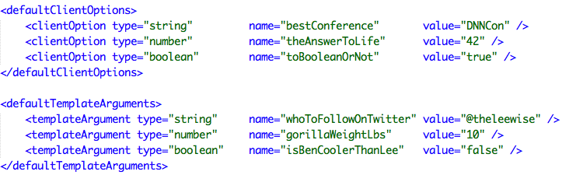
Options in Manifest

Slide 19
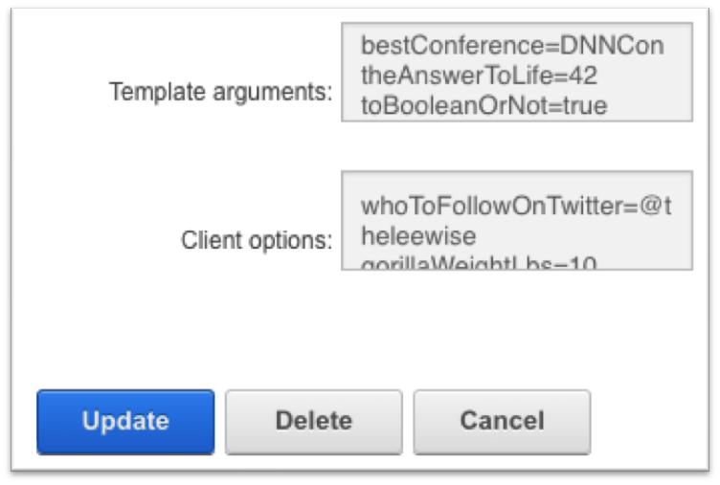
Options on Module
Module options are set through the standard module settings. Template arguments and client options should be supplied as one or more lines in Setting=Value format.

Slide 20
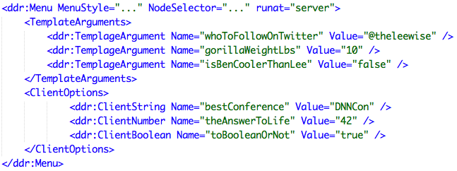
Options in Skin Object

Slide 21
Client Options
Client options are name/value pairs that can be passed as a JSON object to jQuery plug-ins and most other JavaScript menus.
They are given to the template as an argument called Options that can then be passed on to the client-side code.

Slide 22
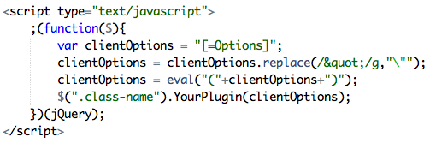
Client Options in the template (Tokens)

Slide 23

Client Options in the template (XSLT)

Slide 24

Resources
https://github.com/10-Pound-Gorilla/DNNCON-16-DDR-and-jQuery
http://www.dnnsoftware.com/wiki/Page/DDRMenu-user-guide
http://www.dnnsoftware.com/wiki/Page/DDRMenu-token-templates
http://www.dnnsoftware.com/wiki/Page/DDRMenu-reference-guide

Slide 25









THANKS TO ALL OF OUR GENEROUS SPONSORS!

